Slide 1
// include/linux/cdev.h
struct cdev {
struct kobject kobj;
struct module *owner;
const struct file_operations *ops;
struct list_head list;
dev_t dev;
unsigned int count;
} __randomize_layout;
// rust/bindings/bindings_helper.h
#include <linux/cdev.h>
// rust/bindings/bindings_generated.rs
#[repr(C)]
#[derive(Copy, Clone)]
pub struct cdev {
pub kobj: kobject,
pub owner: *mut module,
pub ops: *const file_operations,
pub list: list_head,
pub dev: dev_t,
pub count: core::ffi::c_uint,
}
// rust/kernel/chrdev.rs
/// Character device.
///
/// # Invariants
/// - [`self.0`] is valid and non-null.
struct Cdev(*mut bindings::cdev);
struct RegistrationInner<const N: usize> {
cdevs: [Option<Cdev>; N],
}
pub struct Registration<const N: usize> {
inner: Option<RegistrationInner<N>>,
}
impl Cdev {
fn alloc(……) -> Result<Self> {
// SAFETY: FFI call.
let c=unsafe{bindings::cdev_alloc()};
}
// rust/kernel/driver.rs pub trait DriverOps {
/// # Safety
/// `reg` must point to valid, initialised, and writable memory.
unsafe fn register(
reg: *mut Self::RegType,…) -> Result;
}
// samples/rust/rust_chrdev.rs
module! {
type: RustChrdev,
name: "rust_chrdev",
author: "Rust for Linux Contributors",
}
struct RustFile;
struct RustChrdev {
_dev: Pin<Box<chrdev::Registration<2>>>,
}
impl kernel::Module for RustChrdev {
fn init(……) -> Result<Self> { let mut chr = chrdev::Registration::new_pinned(……)?;
chr.as_mut().register::<RustFile>()?;
Ok(RustChrdev { _dev: chr })
}
}
impl Drop for RustChrdev {
fn drop(&mut self) {……}
}
(a)
(b)
(c)

Slide 2
// In C
struct elements {
int len; void* inner;
}; struct factory {
struct elements factory_inner;
};
struct factory thread_thread = {
.factory_inner = {
.len = 256, .inner = thread_ptr }
};
struct factory proxy_thread = {
.factory_inner = {
.len = 256, .inner = proxy_ptr }}
;
// In Rust
pub struct elements<const N: usize> {
inner: [i32; N],
} pub struct factory {
factory_inner: elements<8/256>,
}
let thread_factory = factory { factory_inner:
elements::< 8/256 > { inner: [0; 8/256] } }; let proxy_factory = factory { factory_inner:
elements::< 8/256 > { inner: [0; 8/256] } };
// In Rust but inflexible
pub struct elements<const N: usize> {
inner: [i32; N],
} trait dyn_num { // fn use_elements(&self); } pub struct factory {
factory_inner: &'static dyn dyn_num
}
struct thread<const T: usize>{
thread_elements: elements<T>,
} impl dyn_num for thread<256> {}
struct proxy<const T: usize>{
proxy_elements: elements<T>,
} impl dyn_num for proxy<8> {}
static thread_factory_inner: thread<256> = thread {
thread_elements: elements { inner: [0; 256] },
}; static proxy_factory_inner: proxy<8> = proxy {
proxy_elements: elements { inner: [1; 8] },
};
let thread_factory = factory { factory_inner:
&thread_factory_inner }; let proxy_factory = factory {factory_inner:
&proxy_factory_inner };
(a)
(b)

Slide 3
Study the RFL codes
Collect discussions and presentations
Analyze RFL issues and BUGs
Find RFL Linux kernel drivers

Slide 4
Collect and study RFL related data and materials
RQ1: What’s the status quo of RFL?
RQ2: Does RFL live up to the hype?
RQ3:Where the RFL will go in next?

Slide 5
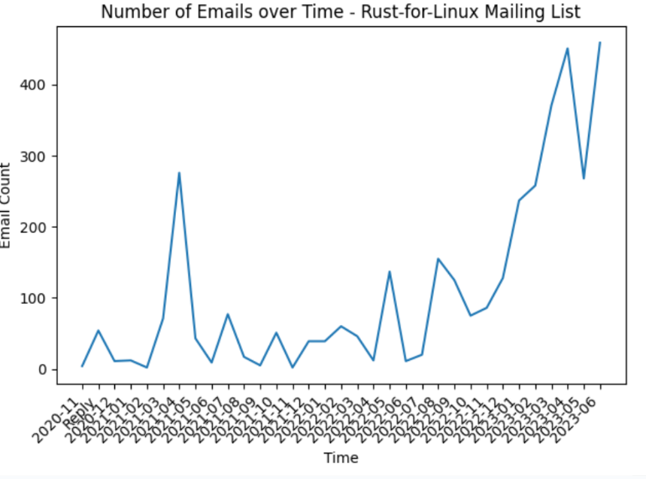
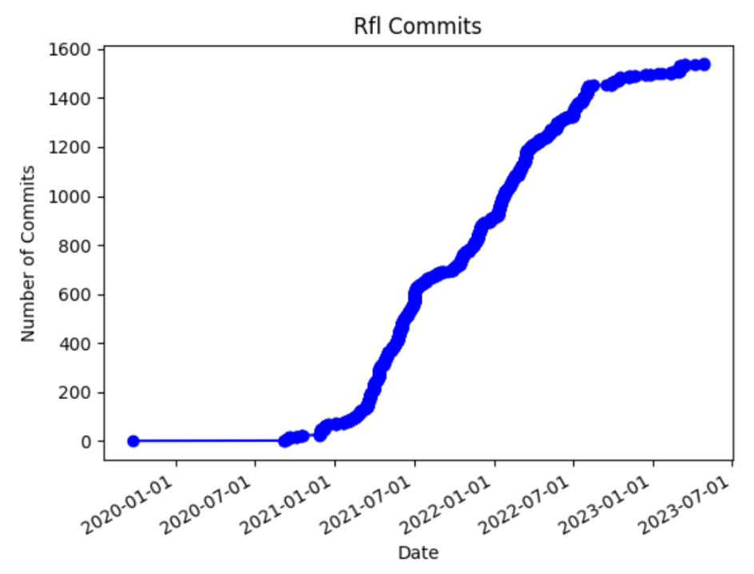
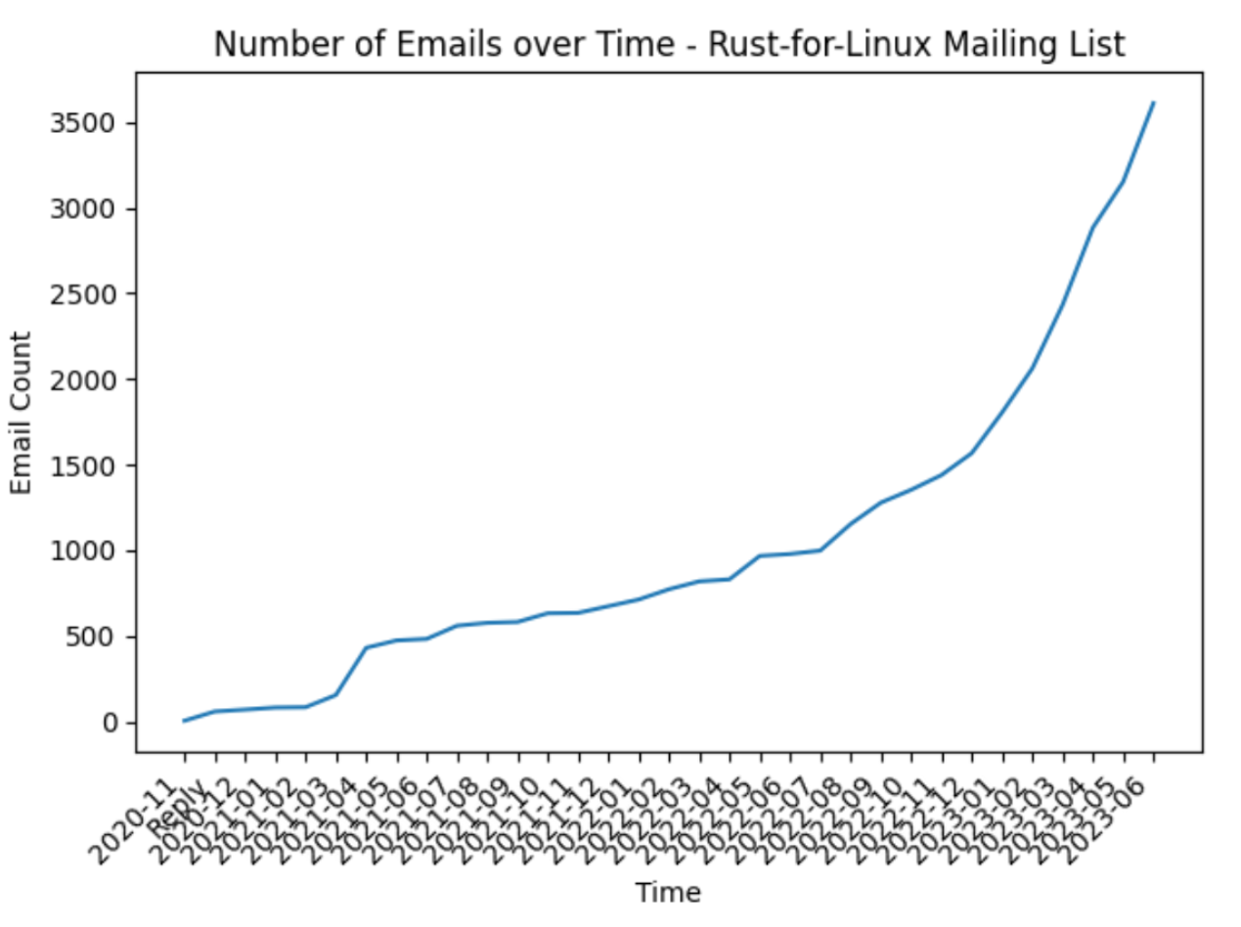
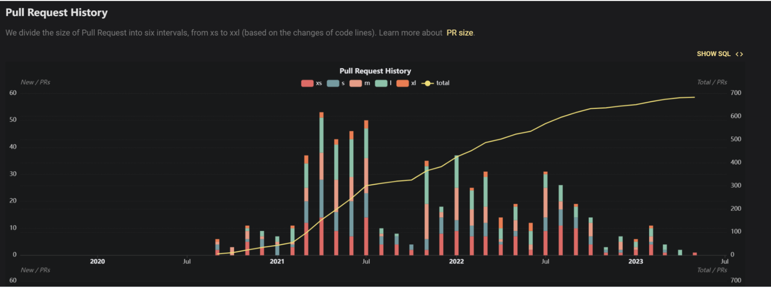
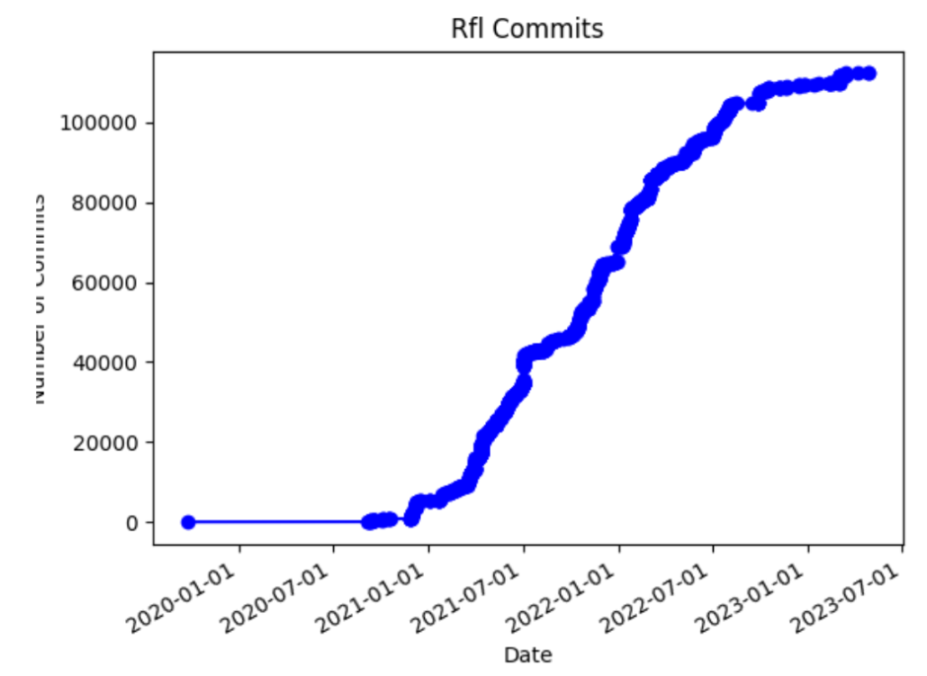
Sum of # 还是直接的 #
CoL
PR和社区的email肯定有重合 这个怎么说明

Slide 6
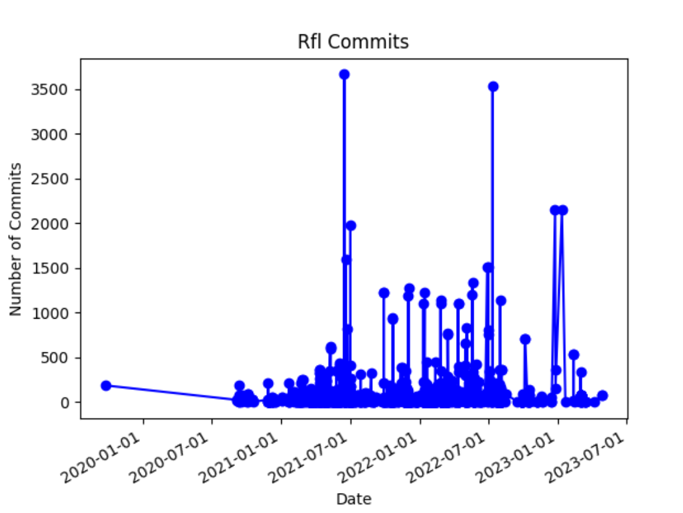
Sum of # 还是直接的 #
CoL
PR和社区的email肯定有重合 这个怎么说明

Slide 7
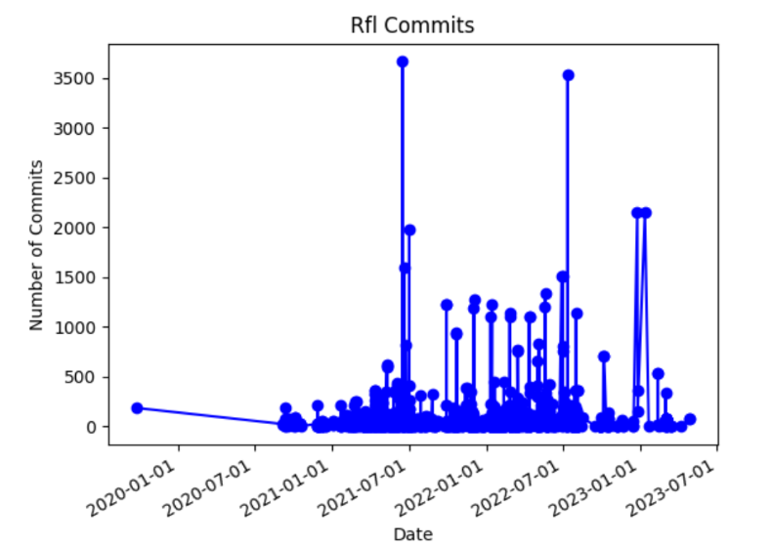
Sum of # 还是直接的 #
CoL
PR和社区的email肯定有重合 这个怎么说明

Slide 8
Sum of # 还是直接的 #
CoL
PR和社区的email肯定有重合 这个怎么说明

Slide 9
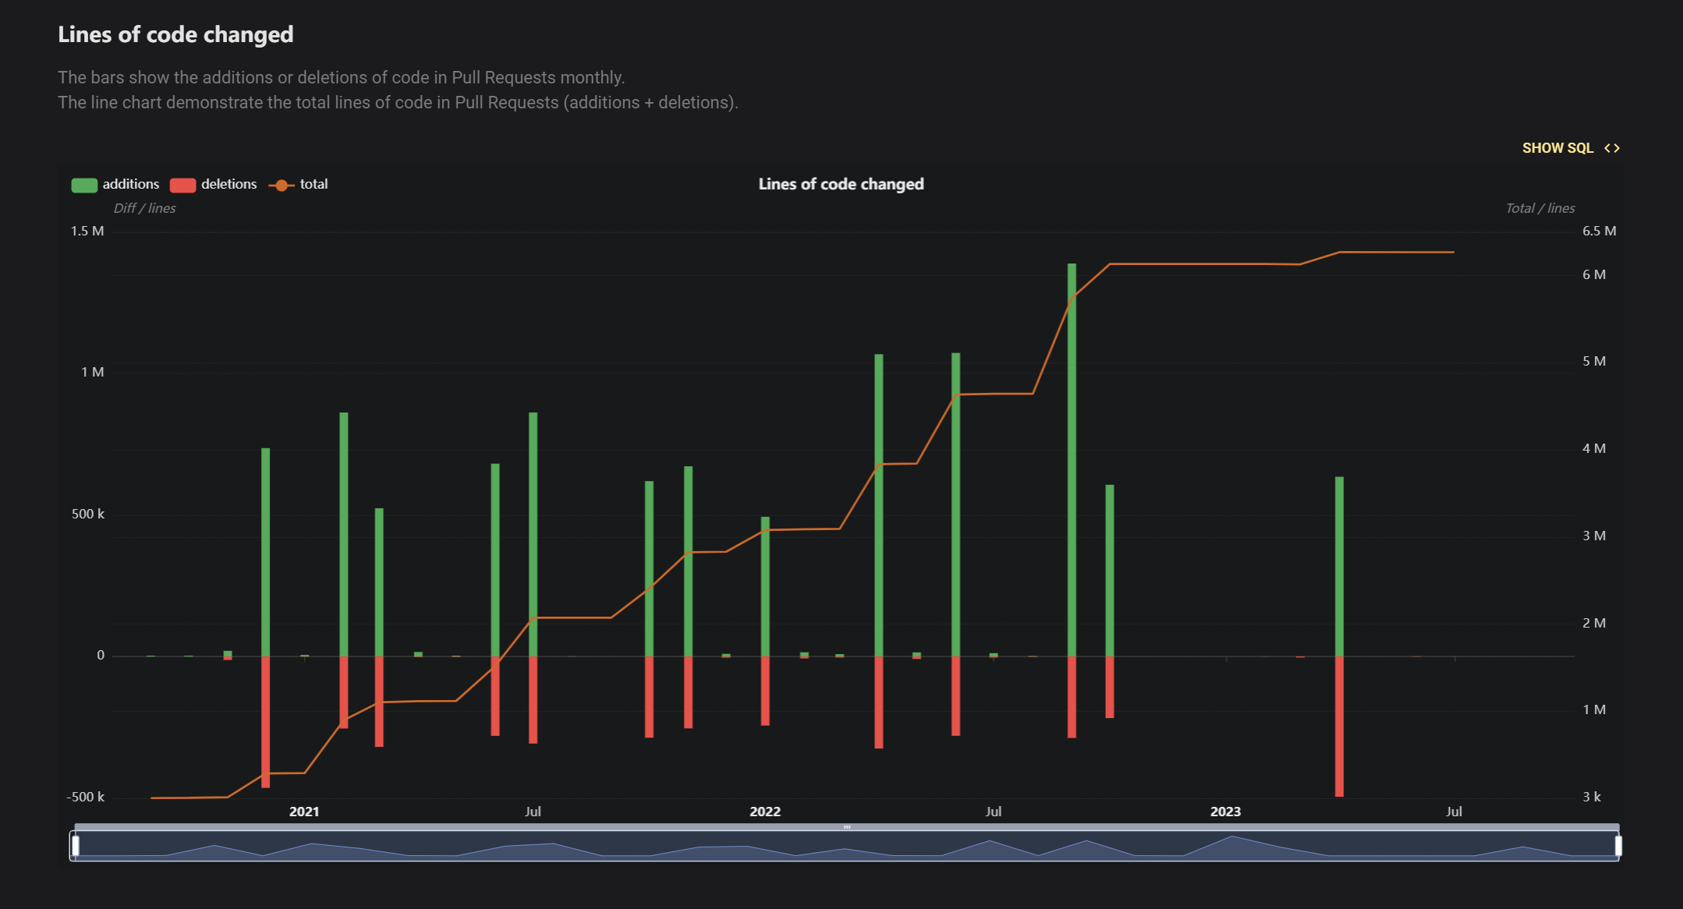
Sum of # 还是直接的 #
CoL
PR和社区的email肯定有重合 这个怎么说明

Slide 10
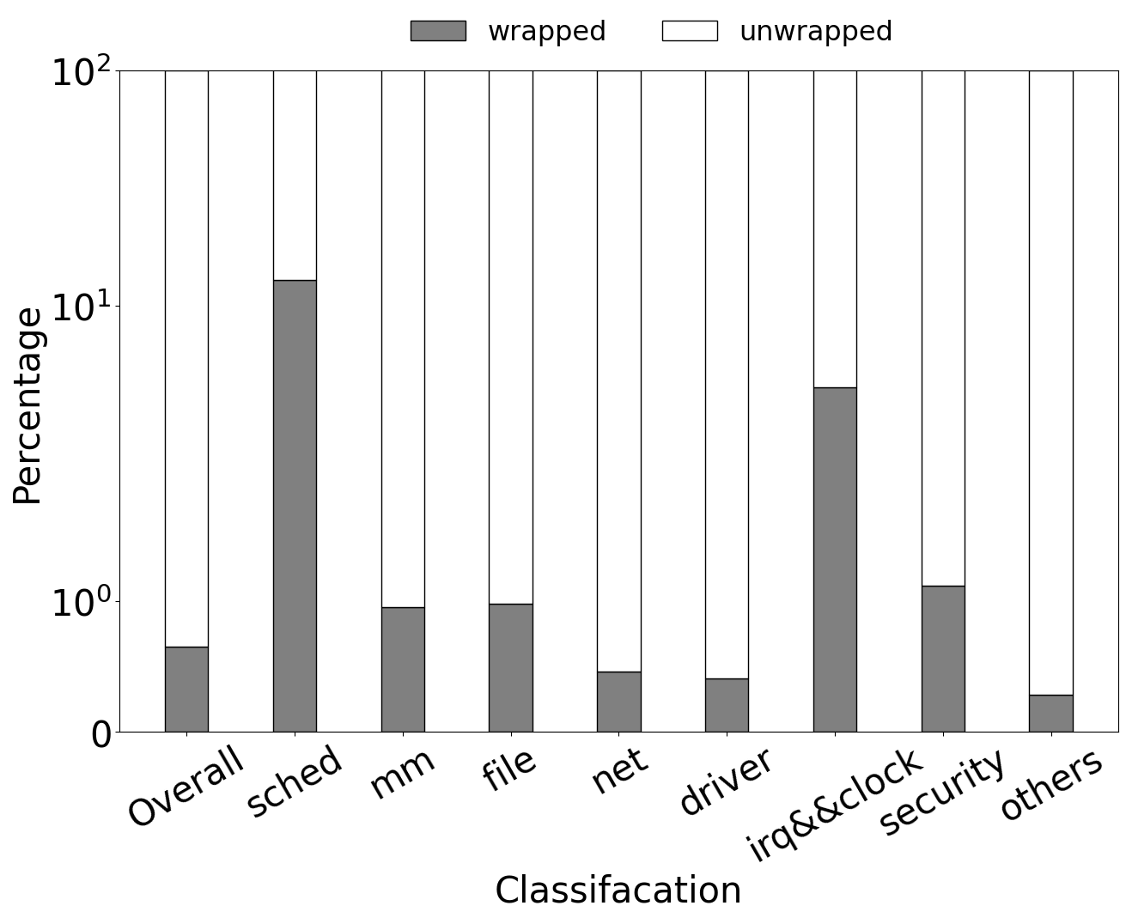
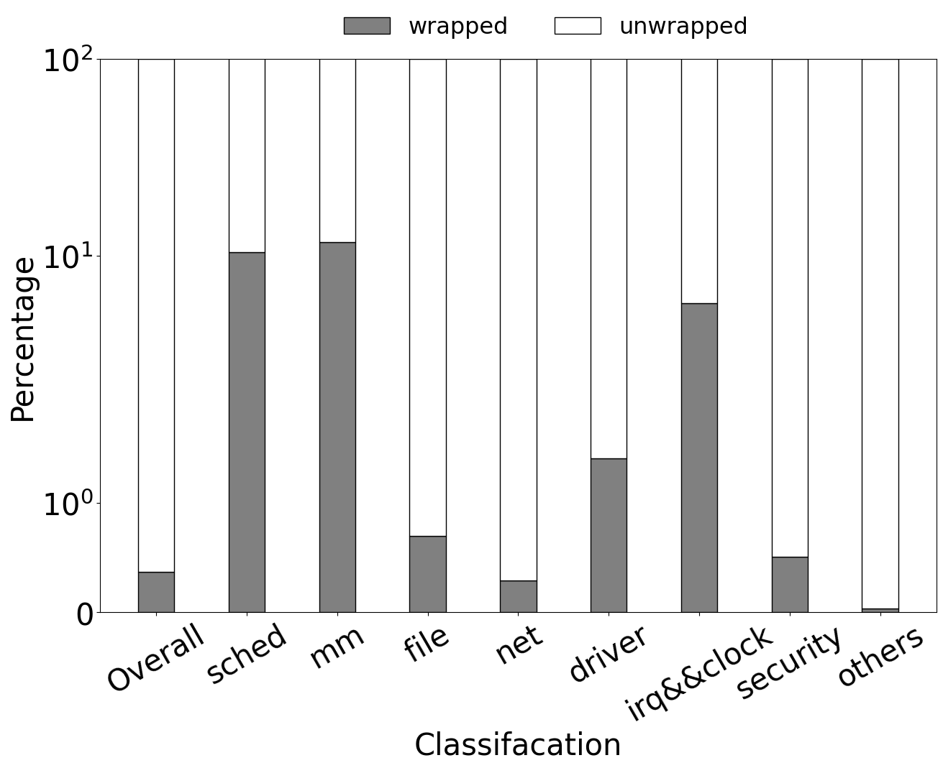
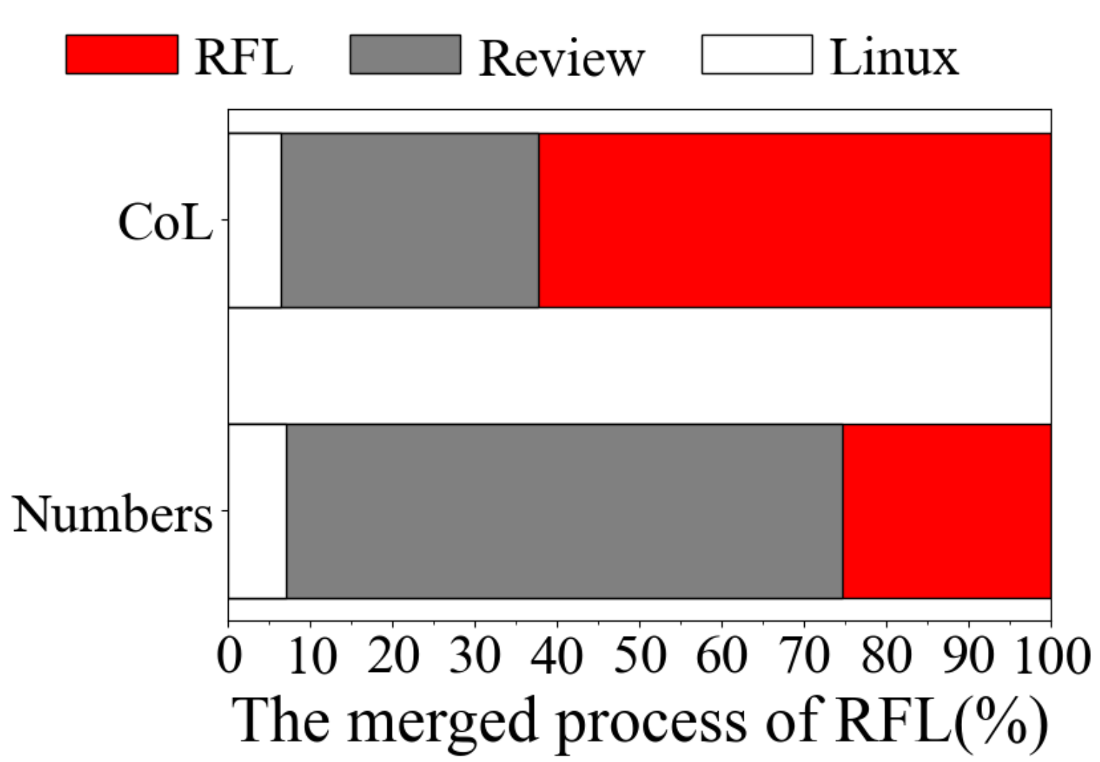
7.1%
37.6%
6.4%
74.6%
(a) The progress of the wrapped struts
(b) The progress of the wrapped functions
(c) The progress of the wrapped struts

Slide 11
7.1%
37.6%
6.4%
74.6%

Slide 13
RQ1: What’s the status quo of RFL?
Data structers
RQ3:Where the RFL will go in next?

Slide 15
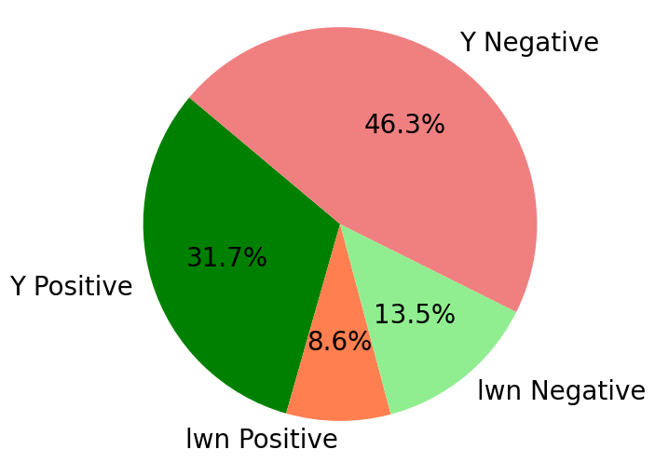
Top5 of Positive reasons:
Safety and Memory Safety
Compatibility and Integration
Performance and Efficiency
Code Quality and Standards
Expressiveness and Features
Top5 of Negative reasons:
Learning Curve and Complexity
Kernel Compatibility
Resource Allocation
Developer Sentiment
Advocacy and Hype
(a) The percentage of different opinions
(b) The specific reasons

Slide 16
Top5 of Positive reasons:
Safety and Memory Safety
Compatibility and Integration
Performance and Efficiency
Code Quality and Standards
Expressiveness and Features
Top5 of Negative reasons:
Learning Curve and Complexity
Kernel Compatibility
Resource Allocation
Developer Sentiment
Advocacy and Hype

Slide 18
290
290
2013 Taesoo Kim started to use Rust writing Linux kernel drivers
2021 Miguel Ojeda gave an RFL RFC in the mailing list
290
2020 Nick started a session in LPC to bring attention from the community
290
2020 The first PR of RFL was committed by Miguel Ojeda on the GitHub
290
290
2019 Alex and Thomas presented the linux-kernel-module-rust project
2022 RFL was merged into the Linux mainline in 6.1

Slide 19
290
290
2013 First project started to use Rust writing Linux kernel drivers
2021 First RFC of RFL in the mailing list
290
2020 First session in LPC to bring attention from the community
290
2020 First PR of RFL was committed on the GitHub
290
290
2019 First public presentation of the linux-kernel-module-rust project
2022 RFL was merged into the Linux mainline in 6.1

Slide 21
// include/linux/cdev.h
struct cdev {
struct kobject kobj;
struct module *owner;
const struct file_operations *ops;
struct list_head list;
dev_t dev;
unsigned int count;
} __randomize_layout;
// rust/bindings/bindings_helper.h
#include <linux/cdev.h>
// rust/bindings/bindings_generated.rs
#[repr(C)]
#[derive(Copy, Clone)]
pub struct cdev {
pub kobj: kobject,
pub owner: *mut module,
pub ops: *const file_operations,
pub list: list_head,
pub dev: dev_t,
pub count: core::ffi::c_uint,
}
// rust/kernel/chrdev.rs
/// Character device.
///
/// # Invariants
/// - [`self.0`] is valid and non-null.
struct Cdev(*mut bindings::cdev);
struct RegistrationInner<const N: usize> {
cdevs: [Option<Cdev>; N],
}
pub struct Registration<const N: usize> {
inner: Option<RegistrationInner<N>>,
}
impl Cdev {
fn alloc(……) -> Result<Self> {
// SAFETY: FFI call.
let c=unsafe{bindings::cdev_alloc()};
}
// rust/kernel/driver.rs pub trait DriverOps {
/// # Safety
/// `reg` must point to valid, initialised, and writable memory.
unsafe fn register(
reg: *mut Self::RegType,…) -> Result;
}
// samples/rust/rust_chrdev.rs
module! {
type: RustChrdev,
name: "rust_chrdev",
author: "Rust for Linux Contributors",
}
struct RustFile;
struct RustChrdev {
_dev: Pin<Box<chrdev::Registration<2>>>,
}
impl kernel::Module for RustChrdev {
fn init(……) -> Result<Self> { let mut chr = chrdev::Registration::new_pinned(……)?;
chr.as_mut().register::<RustFile>()?;
Ok(RustChrdev { _dev: chr })
}
}
impl Drop for RustChrdev {
fn drop(&mut self) {……}
}
(a)
(b)
(c)

